Slide 1
SQL NOTES
ORIOL ORDI

Slide 2
INDEX
THE BASICS
1. QUERY ORDER
2. SELECT
3. FROM
4. LIMIT
JOINING TABLES
1. JOIN
FILTERING TABLES
1. WHERE
2. CASE
3. IN
4. BETWEEN
5. LIKE
6. DISTINCT
7. GROUP BY
8. AGGREGATION FUNCTIONS
9. ORDER BY
WINDOW FUNCTIONS
1. OVER AND PARTITION BY
2. COMMON WINDOW FUNCTIONS
3. FIRST_VALUE AND LAST_VALUE
4. LEAD
5. LAG
6. TIME SERIES WITH WINDOW FUNCTIONS

Slide 3
INDEX
STRING FUNCTIONS
1. STRING FUNCTIONS
MATH FUNCTIONS
1. MATH FUNCTIONS
TRIVIA
1. NULL
2. COALESCE
3. INTO
4. CAST
5. COMMENTS
6. DESCRIBE
UNIONS
1. UNION, UNION ALL, INTERSECT, EXCEPT
SUBQUERIES
1. SUBQUERIES

Slide 4
INDEX
COMMON TABLE EXPRESSIONS
1. COMMON TABLE EXPRESSIONS
DATABASE MANAGEMENT
1. CREATE AND DELETE DATABASES
2. INFORMATION SCHEMA
3. CREATE TABLE
4. SQL DATA TYPES
5. DROP DATABASE
6. DROP TABLE
7. ADD, DROP AND REANME COLUMNS
8. CHANGE DATA TYPES OF COLUMNS
MANAGING DATABASE VALUES
1. INSERT INTO
2. UPDATE
3. DELETE
4. TRUNCATE
VARIABLES
1. VARIABLES
DATES
1. DATEADD
2. DATEDIFF
3. EXTRACT
VIEWS
1. VIEW

Slide 5
QUERY ORDER
SELECT table.column, other_table.other_column
FROM table
JOIN other_table
ON table.column = other_table.column
WHERE condition
GROUP BY column
HAVING condition (on an aggregation such as AVG, SUM, etc)
ORDER BY column
LIMIT number OFFSET number
*LIMIT and OFFSET have different names and behavior in different SQLs

Slide 6
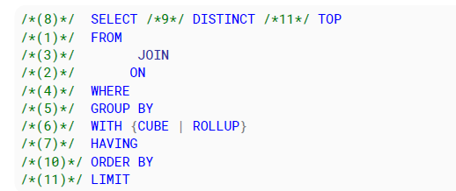
QUERY ORDER
LOGICAL ORDER OF QUERY PROCESSING IN SQL:

Slide 7
SELECT, FROM AND LIMIT

Slide 8
SELECT
SELECT indicates what should be selected
SELECT * → Selects all columns (not best practice to use this for production)
SELECT column_name1, colum_name2 → Selects the columns names
* if a column name is a reserved word, use double quotes (“column_name1”)
SELECT table_name1.column_name1 → Selects the column from the table
SELECT table_name1.column_name1 AS c1 → Selects column name with Alias “c1”
* an alias that is defined in a SELECT clause, can’t be used in that SELECT clause
* if the alias is more than one word, it can be defined within double quotes (“c1 alias”)

Slide 9
SELECT CLAUSES
Clauses that can go inside a SELECT
A column name or multiple column names from one or multiple tables
DISTINCT column names
A Subquery
An Aggregation function (COUNT, SUM, AVG, …)
Mathematical formulas (+, -, *, /, …), for example to combine columns
A CASE statement

Slide 10
FROM
FROM indicates from what table the data should be selected
FROM table_name → Selects from that table
FROM table_name AS table_alias → Selects from that table with that alias
FROM table_name table_alias → Selects from that table with that alias
FROM database_name.table_name → Selects from that table in that database
FROM table_name1, table_name2
WHERE table_name1.key = table_name2.key

Slide 11
FROM CLAUSES
Clauses that can go inside a FROM
A table name
A Subquery that returns a table

Slide 12
LIMIT
LIMIT indicates how many rows will be retrieved
LIMIT 3→ MySQL (limit goes at the end of the query)
SELECT TOP(8) columns → SQL Server
SELECT TOP(5) PERCENT columns → SQL Server (returns the top 5 percent rows)

Slide 13
JOINING TABLES

Slide 14
JOIN
JOIN is used to merge tables together on a column that relates them (also see: ON)
- (INNER) JOIN table_name - LEFT (OUTER) JOIN table_name
- RIGHT (OUTER) JOIN table_name - FULL (OUTER) JOIN table_name
* there can be multiple JOIN statements within a query (joining multiple tables into one)
* it is possible to JOIN a table with itself but then the tables MUST have alias (2 different ones)
The INNER and OUTER keywords are optional

Slide 15
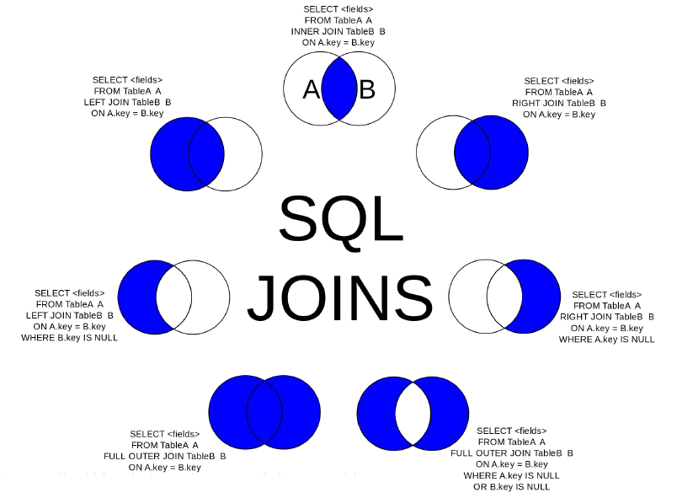
JOIN
RIGHT JOIN
LEFT JOIN
FULL JOIN

Slide 16
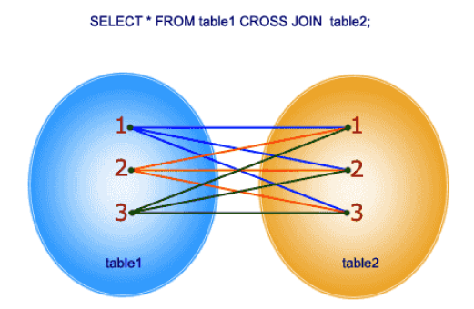
CROSS JOIN
CROSS JOIN is used to join each row from the 1st table with ALL the rows from the 2nd table

Slide 17
ON
ON indicates two columns from two tables where the data should be joined
SELECT column
FROM table
JOIN other_table
ON table.country_name = other_table.name_of_country
ON can take multiple conditions and with multiple joined tables. For example:
ON table3.id = table1.id AND table2.year = table3.year

Slide 18
USING
USING indicates the same column name from two tables where the data should be joined
SELECT column
FROM table
JOIN other_table
USING (name_of_column_to_join)
* Note: this only works if name_of_column_to_join has the same name in both tables.
* Second note: The parenthesis around the column name after USING is mandatory

Slide 19
FILTERING TABLES AND PLAYING WITH CONTENT

Slide 20
WHERE
WHERE is used to filter data based on a condition for a row
WHERE numbered_column > given_number
WHERE column = value
* where operators: >, <, >=, <=, =, <>
WHERE column IN (value1, value2, value3, …)
WHERE column LIKE ‘value’

Slide 21
WHERE CLAUSES
Clauses that can go inside a WHERE
A simple condition on a column
A LIKE clause
An IN clause
Multiple conditions based on AND, OR, NOT
A subquery

Slide 22
CASE
CASE defines column values based on conditions
CASE WHEN numbered_column > 50 THEN ‘big’
WHEN numbered_column < 50 AND numbered_column > 25 THEN ‘medium’
ELSE ‘small’ END AS case_column_alias
* CASE must always be aliased at the end in SELECT clauses (but not in WHERE, ORDER BY…)
* inside each WHEN THEN, there can be multiple conditions, even based on multiple columns. Example: CASE WHEN amount > 50 AND country = ‘France’ THEN ‘fa’

Slide 23
CASE
Useful trick with CASE: Calculate totals or percentages of conditions with SUM and AVG:
Calculate totals of conditions:
SELECT SUM(CASE WHEN condition THEN 1 ELSE 0 END) AS total
FROM table_name
Calculate percentages of conditions (multiply by 100 to make it a percentage, though):
SELECT AVG(CASE WHEN condition THEN 1 ELSE 0 END) AS total
FROM table_name

Slide 24
IN
IN let’s us specity a list of values to check if our value is in the list
WHERE country (NOT) IN (‘France’, ‘Spain’, ‘Germany)
* notice that NOT can be used before IN to get the opposite of what we specify
* also notice that the contents of the list are between parenthesis

Slide 25
BETWEEN
BETWEEN let’s us specity start and end of values
WHERE spending BETWEEN 30 AND 150
WHERE country BETWEEN ‘F’ AND ‘L’ → returns all countries that start with F, G, H, I, J, K and L
* the BETWEEEN operator is inclusive on both sides

Slide 26
LIKE
LIKE is used with WHERE and regular expressions to find strings with conditions
SELECT country
FROM country_gdp
WHERE country (NOT) LIKE ‘F%’
* the next slide explains how the regular expressions in LIKE work
* notice that NOT can be used before LIKE to get the opposite of what we specify

Slide 27
LIKE + REGULAR EXPRESSIONS
% → zero, one, or many alphanumeric characters
_ → one alphanumeric character
[characters] → any character inside the brackets
[^characters] → any character NOT inside the brackets
[character1-character2] → a range of character between character1 and character2
A few examples to better understand this on the next page

Slide 28
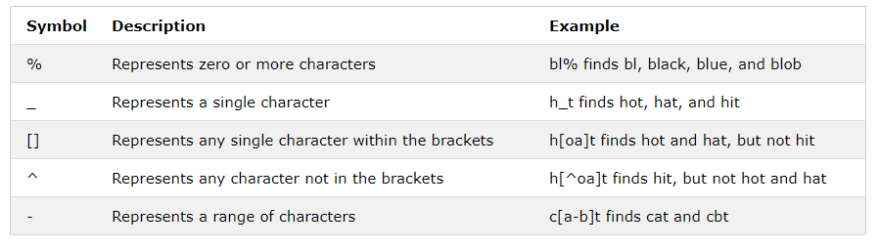
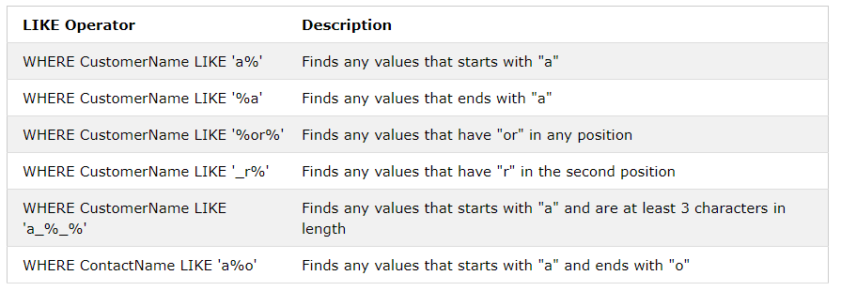
LIKE + REGULAR EXPRESSIONS EXAMPLES
Examples 1
Examples 2

Slide 29
LIKE + REGULAR EXPRESSIONS: ESCAPE
If an escape character is needed inside the regular expression (for example, we need to find all names that start with an underscore), it can be done with ESCAPE like this:
SELECT name
FROM table
WHERE name LIKE ‘/_%’ ESCAPE ‘/’

Slide 30
LIKE + REGULAR EXPRESSIONS: ESCAPE
Another example of ESCAPE: Finding a name that starts with %, has two characters, then an underscore and then any number of characters finishing with any lowercase letter:
SELECT name
FROM table
WHERE name LIKE ‘/%__/_%[a-z]’ ESCAPE ‘/’

Slide 31
DISTINCT
DISTINCT selects distinct values, similar to sets in python or the .unique() method in pandas
SELECT DISTINCT tree → returns each type of tree in the forests table once
FROM forests
SELECT COUNT (DISTINCT tree) → returns the number of types of tree in the forests table
SELECT DISTINCT (tree, bird) → returns the number of distinct combinations of tree
and bird in the forests table

Slide 32
GROUP BY
GROUP BY groups according to columns to perform aggregation functions on other columns
SELECT country, AVG(spending)
FROM city_spending
GROUP BY country
Remember: Group by must group ALL non-aggregated fields

Slide 33
AGGREGATION FUNCTIONS
Aggregation functions do an aggregation on groups created by GROUP BY
COUNT(*) → Counts the number of rows of the table
COUNT(column_name) → Counts non null number of rows of column_name
COUNT(DISTINCT column_name) → Counts the number distinct elements of column_name
SUM(column_name)
AVG(column_name)
MIN(column_name)
MAX(column_name)

Slide 34
AGGREGATION FUNCTIONS WITH CASE
Aggregation functions can be used with case to, for example, count the number of rows in a column that match a condition. Like this:
SELECT COUNT(Id) AS ItemsCount,
SUM ( CASE
WHEN PriceRating = 'Expensive' THEN 1
ELSE 0
END) AS ExpensiveItemsCount
FROM ItemSales

Slide 35
HAVING
HAVING is basically a WHERE for aggregated fields.
*This means that fields that have been aggregated with COUNT, SUM, AVG, MIN, MAX, don’t work on WHERE clauses so they have to go in HAVING clauses
SELECT country
FROM city_spending
WHERE country IN (‘France’, ‘Spain’, ‘Germany’)
GROUP BY country
HAVING AVG(spending) > 50
HAVING works with the same operators as WHERE (AND, OR, NOT, IN, LIKE, BETWEEN…)

Slide 36
ORDER BY
ORDER BY orders the rows according to one or multiple columns
SELECT country, gdp
FROM country_gdp
ORDER BY gdp DESC, country
* this query selects country and gdp from country_gdp table and orders the row from highest to lowest (DESC) gdp and if two gdp values are the same, orders the row from lowest to highest (it doesn’t say DESC) country.

Slide 37
ORDER BY WITH CASE
ORDER BY can be used with case to group as we wish
SELECT country, gdp
FROM country_gdp
ORDER BY CASE WHEN country = ‘France’ OR country = ‘Spain’ THEN 0
WHEN country = ‘Germany’ THEN 1
ELSE 2 END
* this query orders placing France and Spain at the top, then Germany, then the rest

Slide 38
WINDOW FUNCTIONS (OVER)

Slide 39
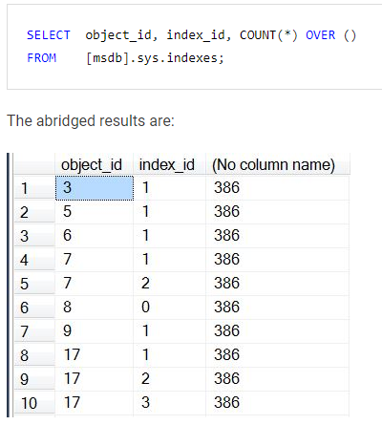
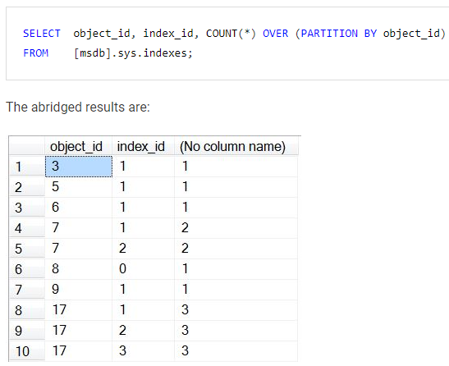
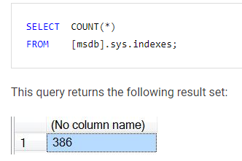
OVER AND PARTITION BY
Without OVER
With OVER
With OVER and PARTITION BY (partition by can be multiple columns)

Slide 40
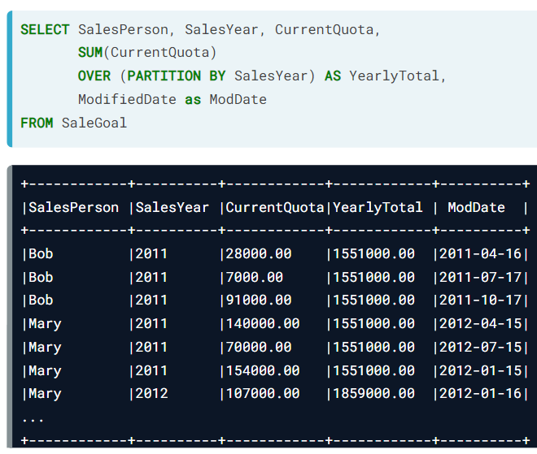
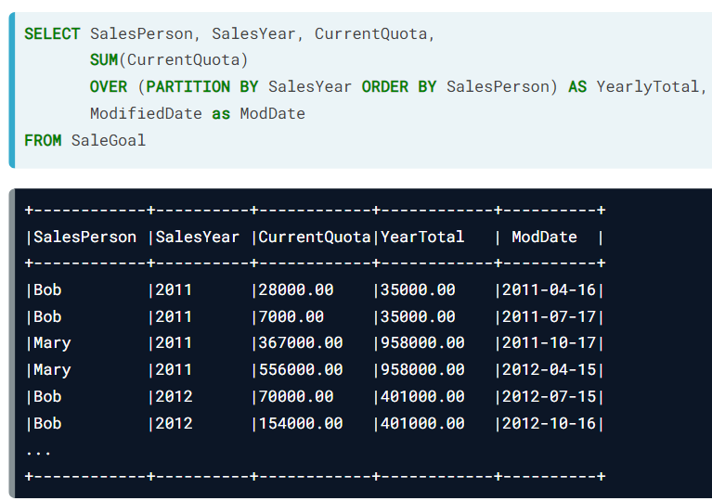
OVER AND ORDER BY (AND PARTITION BY)
Without ORDER BY
With ORDER BY (the SUM changes for every element of the ORDER BY)

Slide 41
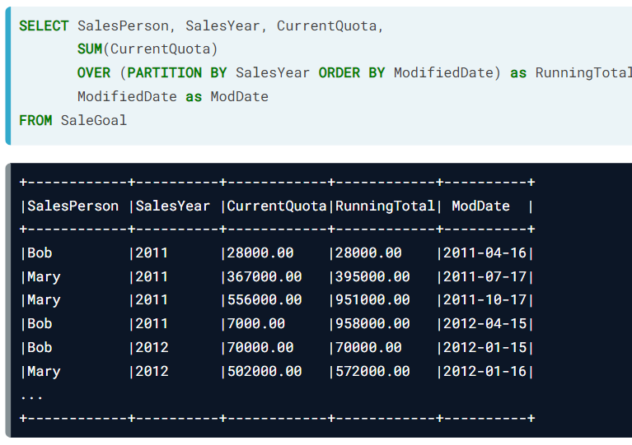
OVER AND ORDER BY (AND PARTITION BY)
Without ORDER BY
With ORDER BY (if in the ORDER BY column all rows are unique, we create a running total with SUM)

Slide 42
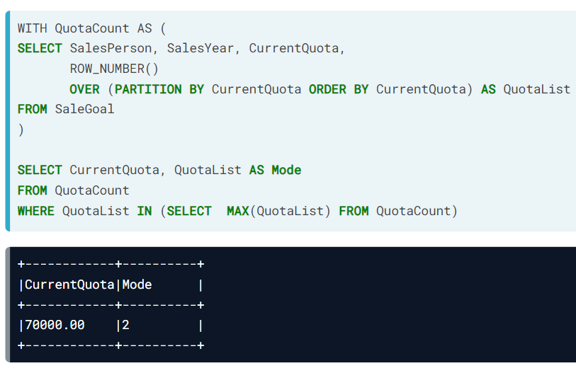
MODE
How to calculate the mode of a column in SQL (using Window Functions and CTE):

Slide 43
COMMON WINDOW FUNCTIONS
FIRST_VALUE returns the first value of the window for all rows of the window
LAST_VALUE returns the last value of the window for all rows of the window
LEAD returns the specified column, one value ahead
LAG returns the specified column, one value behind
Examples in the next pages

Slide 44
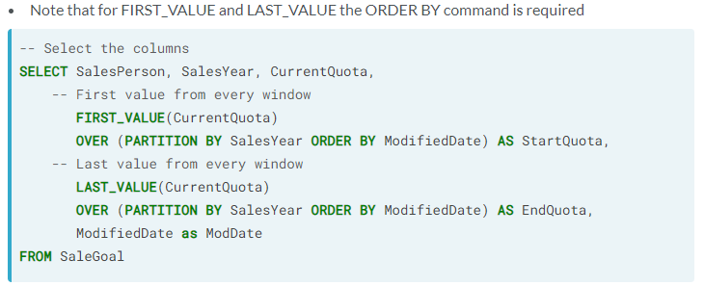
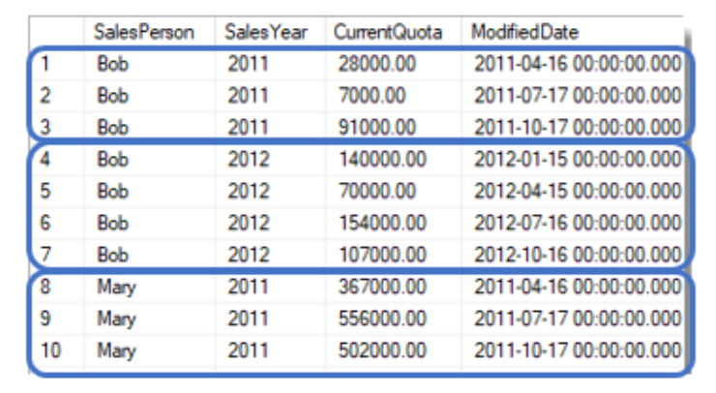
FIRST_VALUE AND LAST_VALUE

Slide 45
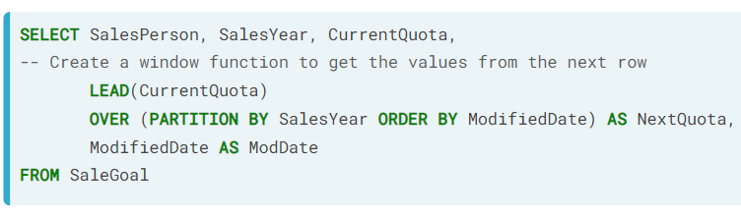
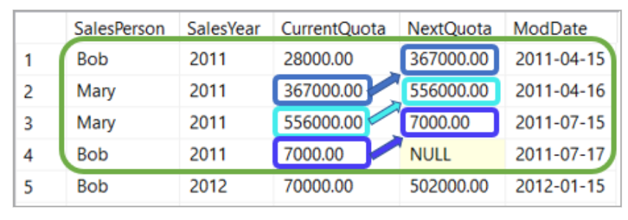
LEAD

Slide 46
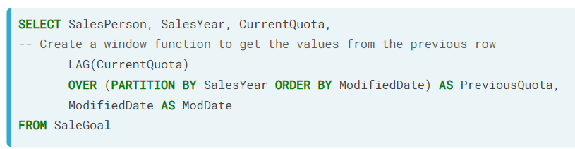
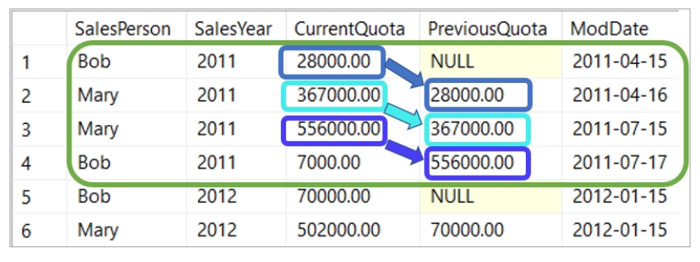
LAG
LAG

Slide 47
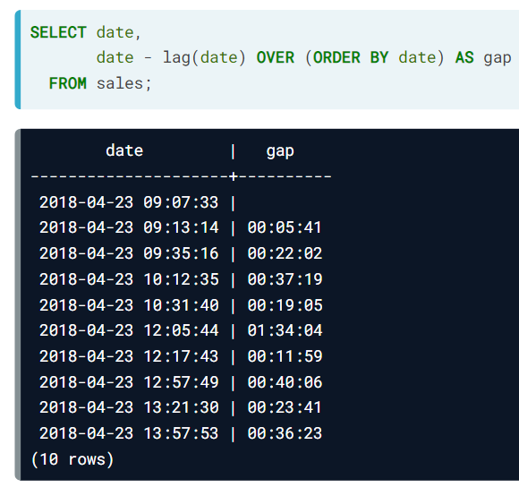
TIME SERIES WITH WINDOW FUNCTIONS
Using LAG and OVER with ORDER BY
we can calculate differences in time between datetime rows

Slide 48
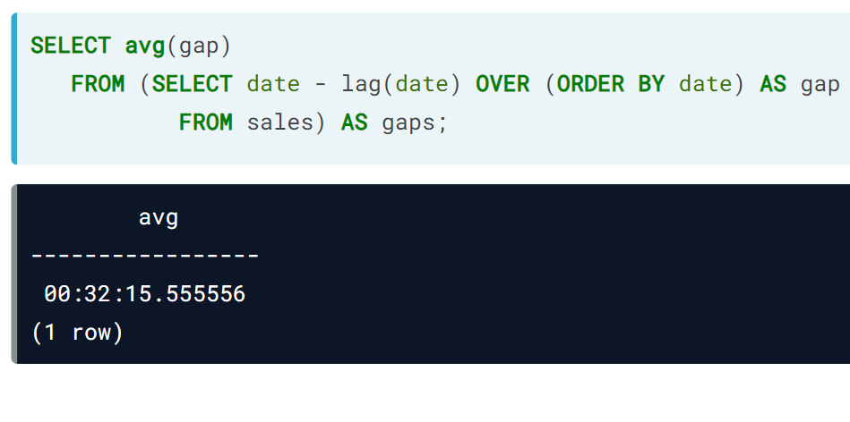
TIME SERIES WITH WINDOW FUNCTIONS
If we want the average of the differences in time between rows, we have to use a subquery, because window functions can’t be used within aggregation functions

Slide 49
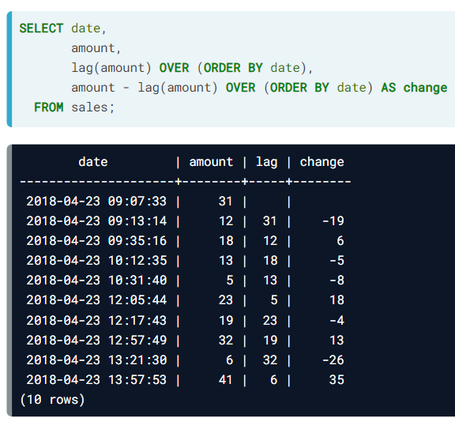
TIME SERIES WITH WINDOW FUNCTIONS
We can also calculate differences in time in non-date rows, but always using a date row in the ORDER BY of the OVER

Slide 50
STRING FUNCTIONS

Slide 51
STRING FUNCTIONS
LEN(string_column) → Returns the length of each row of the string column
LEFT(string_column, number) → Returns number of characters starting from the left
SUBSTRING(string_column, start_char, end_char) → Returns the specified substring of the string
CHARINDEX(string, string_column) → Returns the start index of string in the string column
REPLACE(string_column, old_string, new_string) → Returns all ocurrences of old_string to new_string
WHERE LEN(col) > 0 returns rows
that don’t have blank values
Also there is RIGHT

Slide 52
MORE STRING FUNCTIONS
LOWER(string_column) → Returns the all lowercase version of the string column
UPPER(string_column) → Returns the all uppercase version of the string column
TRIM(string_column) → Returns the string columns with withespaces trimmed
TRIM(string_column, characters) → Returns the string columns with the specified ‘characters’ trimmed
CONCAT(string_1, string_2, string_3) → Returns the concatenation of the specified strings
Also LTRIM and RTRIM

Slide 53
STRING FUNCTIONS PRO TIP
Pro tip for text functions: if we don’t know whether the word we search for is in capital letters or small letters or maybe has only the first capital or some weird combination or it has extra spaces somewhere, turn the column to a trimmed lowercase and then search:
SELECT name
FROM table
WHERE LOWER(TRIM(name)) = ‘whatever_but_all_in_lowercase’
Also works for other WHERE statements
such as LIKE or IN

Slide 54
CONCAT
CONCAT concatenates strings and returns the concatenation.
Example of use:
SELECT CONCAT(‘Ti’, ’nti’, ’n’, ’!’) → Returns ‘Tintin!’
Another example of use:
SELECT CONCAT(‘Ti’, CAST(42 AS VARCHAR(2)), ’in’, ’!’) → Returns ‘Ti42in!’
There are MANY other string functions
that I’m too lazy to include here

Slide 55
MATH FUNCTIONS

Slide 56
MATH FUNCTIONS
ABS(column) → Returns the absolute value of each element of the column
SQRT(column) → Returns the square root of each element of the column
POWER(column, number) → Returns each element of the column to the power of the number
LOG(column) → Returns the natural logarithm of each element of the column
LOG(column, base) → Returns the base-logarithm of each element of the column
If number = 0.5 it’s like doing SQRT

Slide 57
ROUND
ROUND rounds a float to the specified number of decimals.
How to use:
SELECT ROUND(float_or_statement_that_returns_a_float, 2) → Rounds to 2 decimals
Example of use:
SELECT ROUND(AVG(population) / 100.0, 2)
If the number is negative, it rounds
the whole part of the number

Slide 58
TRUNCATE (MYSQL AND POSTGRESSQL)
TRUNCATE truncates a float to the specified number of decimals.
How to use (MySQL):
SELECT TRUNCATE(float_or_statement_that_returns_a_float, 2) → Truncates to 2 decimals
How to use (PostgreSQL):
SELECT TRUNC(float_or_statement_that_returns_a_float, 2) → Truncates to 2 decimals

Slide 59
TRUNCATE (SQL SERVER)
ROUND with a second third parameter equal to 1 truncates a float to the specified number of decimals.
How to use (SQL Server):
SELECT ROUND(float_or_statement_that_returns_a_float, 2, 1) → Truncates to 2 decimals
Example of use:
SELECT ROUND(AVG(population) / 100.0, 2, 1)

Slide 60
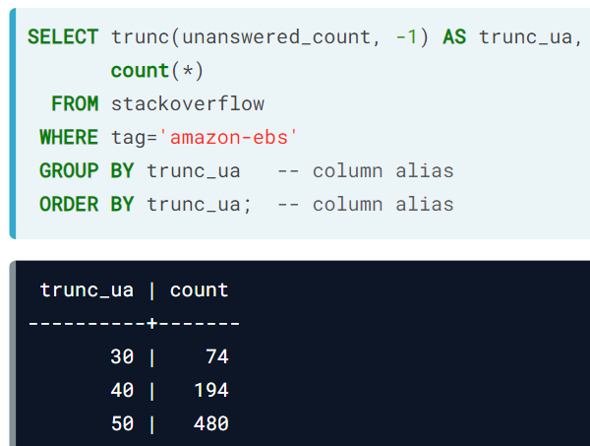
TIP WITH TRUNCATE
TRUNCATE can be used to group by decimal units, for example, such as in the following code:

Slide 61
ARITHMETICS PITFALL
Common pitfall with floats and integers:
Dividing two integers will give you the integer result. Example: 10 / 3 = 3
This means that counting the percentage of non-missing values in a column, for example might look something like this:
SELECT COUNT(column_name) / COUNT(*) * 100
However, this will give the incorrect integer result. At least one of the operands IN EACH OPERATION has to be float for the result to be float!!!
The correct version (together with
more errors) is in the next page:

Slide 62
ARITHMETICS PITFALL
Incorrect version from before:
SELECT COUNT(column_name) / COUNT(*) * 100 → int division + int multiplication
Also incorrect version:
SELECT COUNT(column_name) / COUNT(*) * 100.0 → int division + float multiplication
Correct version:
SELECT COUNT(column_name) * 100.0 / COUNT(*) → float multiplication + float division

Slide 63
TRIVIA

Slide 64
NULL
NULL is a special data type similar to the NaN in pandas
WHERE column IS NULL → correct
WHERE column = NULL → incorrect
WHERE column IS NOT NULL → correct
WHERE column <> NULL → incorrect
SELECT ISNULL(column_name, ‘whatever’) → Returns the column and subsitutes NULL values with ‘whatever’
Also works substituting with another column

Slide 65
COALESCE
COALESCE returns the first non null value from a list
SELECT COALESCE(NULL, NULL, 3, NULL, 7) → Returns 3 (the first non-null value)
Useful in this case, for example, among many others:
SELECT COALESCE(SUM(column_name), 0) → Will return 0 instead of null in the rows
where there is no value to sum

Slide 66
INTO
INTO is used to copy the results of a query into a new table
SELECT column1, column2
INTO new_table_name
FROM table1
WHERE condition1 > 20
* INTO goes always after the SELECT clause and before the FROM clause
* The new table (new_table_name here) can be used for further querying

Slide 67
CAST
CAST converts a data type to another data type. Usage:
Usage:
CAST(column_name AS data_type)
Example:
CAST(windspeed AS integer)

Slide 68
COMMENTS
Comments are done in 2 ways in SQL:
One-line comment: -- ...
-- this is a one-line comment
Multi-line comment: /* … */
/* all of
this are comments
*/

Slide 69
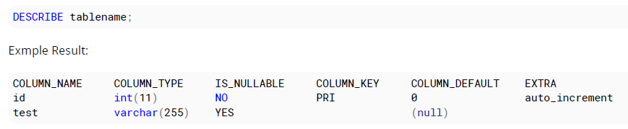
DESCRIBE
DESCRIBE on a table name returns the definition of the columns

Slide 70
SET THEORY
(UNION, UNION ALL, EXCEPT, INTERSECT)

Slide 71
UNION, UNION ALL, INTERSECT, EXCEPT
UNION, UNION ALL, INTERSECT and EXCEPT are used to stack rows on top of each other from different queries that act as one bigger query
* Important: the two queries must be equal in number, name, order and data type of columns
SELECT president, country → Will return a table with 2 rows:
FROM presidents - president, containing presidents and kings UNION - country, containing countries
SELECT king, country * there will be no column named king (kings will be
FROM kings mixed with presidents in the president column)

Slide 72
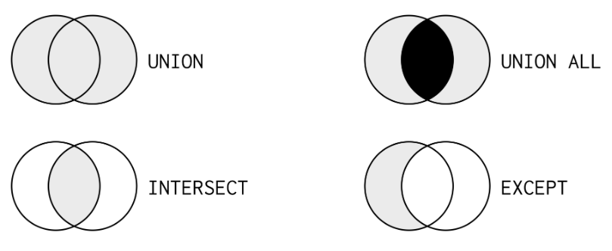
UNION, UNION ALL, INTERSECT, EXCEPT
Rows in either of the tables
Rows in either of the tables, but
rows in both tables are present twice
Rows in both tables
(all the selected columns
must be equal in both tables)
Rows in one table but not the other

Slide 73
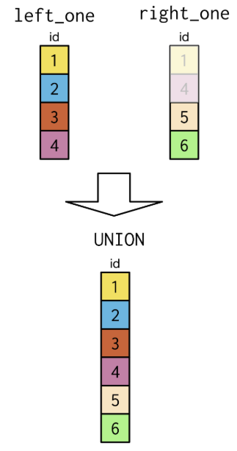
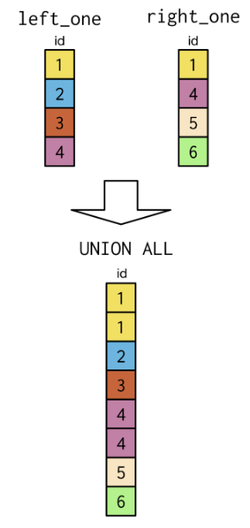
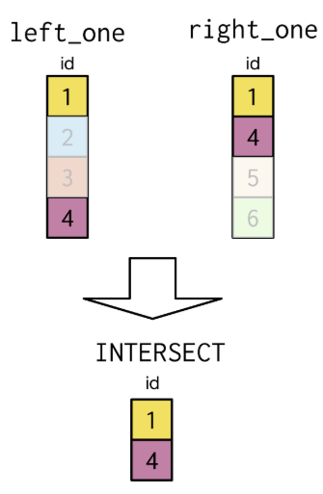
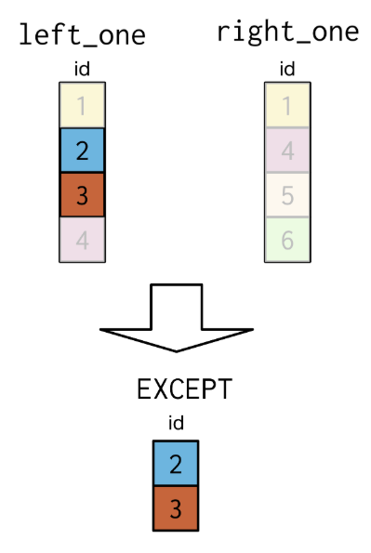
UNION, UNION ALL, INTERSECT, EXCEPT
UNION
UNION ALL
INTERSECT
EXCEPT

Slide 74
SUBQUERIES AND CTE

Slide 75
SUBQUERIES
SUBQUERIES are queries within queries. They can be placed and used in many ways, for example:
WHERE column_name > (subquery_consisting_of_one_number)
WHERE column_name (NOT) IN (subquery_consisting_of_one_column)
SELECT column_name, (subquery_consisting_of_one_value) AS alias_name
FROM (subquery_consisting_of a_table) AS alias_name
Subqueries always go
Inside parenthesis
There can be as many subqueries
as needed in one query

Slide 76
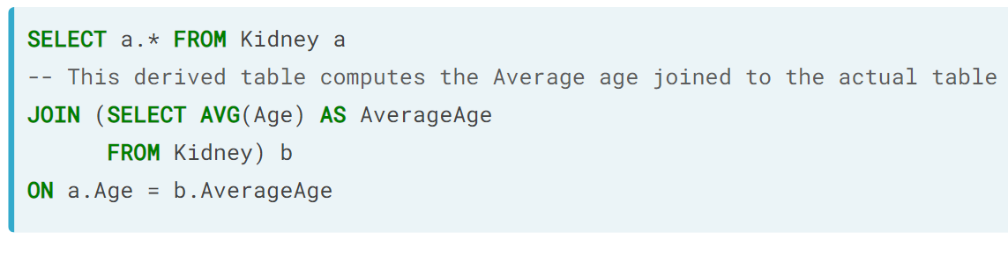
SUBQUERIES
SUBQUERIES ON JOIN:
This query will return all content of all rows from table ‘Kidney’, where the age is equal to the average age

Slide 77
COMMON TABLE EXPRESSIONS
COMMON TABLE EXPRESSIONS (CTE) are tables declared outside of the query
WITH cte_name AS (
SELECT whatever
FROM whatever_table)
The CTE can then be used as any existing table in any query, for example:
SELECT something
FROM cte_name

Slide 78
COMMON TABLE EXPRESSIONS
COMMON TABLE EXPRESSIONS (CTE) are tables declared outside of the query
The column names can be changed in the definition:
WITH cte_name AS (new_column_name_1, new_column_name_2) (
SELECT column_name_1, column_name_2
FROM whatever_table)

Slide 79
COMMON TABLE EXPRESSIONS
COMMON TABLE EXPRESSIONS (CTE) are tables declared outside of the query
To declare multiple CTEs, just separate them with a comma
WITH cte_name_1 AS (
SELECT whatever FROM whatever_table WHERE whatever_condition JOIN whatever_table ON whatever_joining_condition) ,
cte_name_2 AS (
SELECT other_whatever FROM other_whatever_table WHERE other_whatever_condition)

Slide 80
DATABASE MANAGEMENT

Slide 81
CREATE AND DELETE DATABASES
CREATE DATABASE database_name → Creates database with that name
CREATE DATABASE IF EXISTS database_name → Creates database with that name if it exists
DROP DATABASE database_name → Deletes database with that name

Slide 82
INFORMATION SCHEMA
INFORMATION SCHEMA holds metadata on a database. Here are a couple examples:
SELECT table_name → Returns table names in the database
FROM information_schema.tables
SELECT table_name, column_name, data_type → Returns table name of the
FROM information_schema.columns ‘table_name’ table in the
WHERE table_schema = ‘database_name’ ‘database_name’ database with
AND table_name = ‘table_name’ its column names and data types

Slide 83
INFORMATION SCHEMA
INFORMATION SCHEMA holds metadata on a database. Here are a couple examples:
SELECT constraint_name, table_name, constraint_type → Returns constraint names
FROM information_schema.table_constraints and types
WHERE constraint_type= ‘FOREIGN KEY’
AND table_name = ‘table_name’

Slide 84
CREATE TABLE
CREATE TABLE creates a new table. The syntax for table creation is the following:
CREATE TABLE table_name (
column1 data_type_column1,
column2 data_type_column2)
For example:
CREATE TABLE population (
country varchar
population int)

Slide 85
CREATE TABLE
CREATE TABLE creates a new table.
The new table can be created based on a query from existing tables:
CREATE TABLE table_name AS
SELECT column1, column2
FROM table1
WHERE condition

Slide 86
CREATE TABLE (NOT NULL)
NOT NULL → doesn’t allow null values on the column (present or future null values)
CREATE TABLE table_name (
column1 data_type_column1 NOT NULL, → Sets NOT NULL when creating a table
column2 data_type_column2)
ALTER TABLE table_name
ALTER COLUMN column_name → Sets NOT NULL on existing column from table
SET NOT NULL * change SET to DROP to remove constraint

Slide 87
CREATE TABLE (UNIQUE)
UNIQUE → doesn’t allow repeated values on a column (present or future repeated values)
CREATE TABLE table_name (
column1 data_type_column1 UNIQUE, → Sets UNIQUE when creating a table
column2 data_type_column2 NOT NULL UNIQUE)
ALTER TABLE table_name → Sets UNIQUE on existing column from table
ADD CONSTRAINT constraint_name * change ADD to DROP to remove constraint
UNIQUE (column_name) and remove the last line (UNIQUE (column_name))

Slide 88
CREATE TABLE (PRIMARY KEY)
PRIMARY KEY is used to designate a column that uniquely identifies records.
Using PRIMARY KEY on table creation:
CREATE TABLE Persons ( → One column is PRIMARY KEY
id int NOT NULL PRIMARY KEY);
CREATE TABLE Persons ( → One or more columns are PRIMARY KEY col1 int NOT NULL, col2 int, col3 char,
PRIMARY KEY (col1, col3));

Slide 89
CREATE TABLE (PRIMARY KEY)
PRIMARY KEY is used to designate a column that uniquely identifies records.
Using PRIMARY KEY with a created table:
ALTER TABLE Persons → On one column
ADD PRIMARY KEY (id);
ALTER TABLE Persons → On multiple columns
ADD CONSTRAINT pk_person PRIMARY KEY (id ,LastName);

Slide 90
CREATE TABLE (PRIMARY KEY)
PRIMARY KEY is used to designate a column that uniquely identifies records.
Deleting PRIMARY KEY:
ALTER TABLE Persons → On one column
DROP PRIMARY KEY;
ALTER TABLE Persons → On multiple columns (provide constraint name)
DROP CONSTRAINT pk_person;

Slide 91
CREATE TABLE (AUTO INCREMENT)
AUTO INCREMENT is used for a column that has values starting at 1 and incrementing by 1.
This is typically used for an id column that serves as a PRIMARY KEY .
CREATE TABLE table_name( → MySQL
id int NOT NULL AUTO_INCREMENT);
CREATE TABLE table_name( → SQL Server
id int IDENTITY(1,1) PRIMARY KEY);
CREATE TABLE table_name( → PostgreSQL
id int SERIAL PRIMARY KEY);

Slide 92
CREATE TABLE (FOREIGN KEY)
FOREIGN KEY is used for a column that references a PRIMARY KEY from another table.
A FOREIGN KEY must be of the same data type than the PRIMARY KEY it references. Many FOREIGN KEYs can be declared in the same table.
When a column is a FOREIGN KEY, it doesn’t allow values that don’t exist in the PRIMARY KEY column that it references.
How to create FOREIGN KEYS (both in new and exising tables) can be found in the next slides

Slide 93
CREATE TABLE (FOREIGN KEY)
CREATE TABLE table_name( → MySQL
fk int
FOREIGN KEY (fk) REFERENCES other_table_name (primary_key_name_in_other_table);
CREATE TABLE table_name( → SQL Server
fk int FOREIGN KEY REFERENCES other_table_name (primary_key_name_in_other_table);
CREATE TABLE table_name( → PostgreSQL
fk int REFERENCES other_table_name (primary_key_name_in_other_table);

Slide 94
CREATE TABLE (FOREIGN KEY)
ALTER TABLE table_name → Add FOREIGN KEY to existing column
ADD CONSTRAINT constraint_name
FOREIGN KEY (column_name) REFERENCES other_table_name (primary_key_name_in_other_table);
ALTER TABLE table_name → Remove FOREIGN KEY from existing column
DROP CONSTRAINT constraint_name;

Slide 95
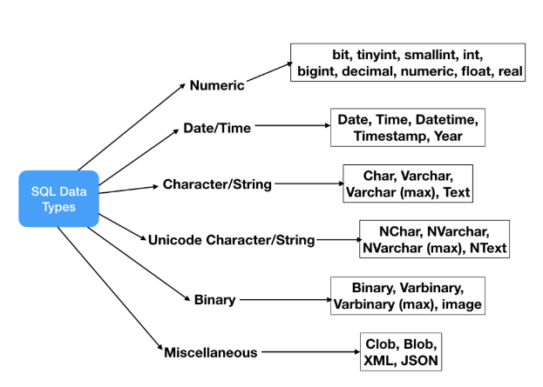
SQL DATA TYPES
Here’s a graph of the different data types in SQL:

Slide 96
DROP DATABASE
DROP DATABASE deletes an existing database. The syntax for database deletion is the following:
DROP DATABASE database_name → Deletes the database
DROP DATABASE IF EXISTS database_name → Deletes the database if it exists

Slide 97
DROP TABLE
DROP TABLE deletes an existing table. The syntax for table deletion is the following:
DROP TABLE table_name → Deletes the table
DROP TABLE database_name.table_name → Deletes the table from that database
DROP TABLE IF EXISTS table_name → Deletes the table if it exists
DROP TABLE IF EXISTS database_name.table_name → Self-explanatory (aka no space to write)

Slide 98
ADD, DROP AND REANME COLUMNS
ALTER TABLE table_name
ADD COLUMN column_name column_type → Adds column to table
ALTER TABLE table_name
DROP COLUMN column_name → Drops column from table
ALTER TABLE table_name
RENAME COLUMN column_name TO new_column_name → Renames column from table
Can be followed by any other instructions from table creation
such as, for example, NOT NULL, or PRIMARY KEY, or UNIQUE

Slide 99
CHANGE DATA TYPES OF COLUMNS
ALTER TABLE table_name
ALTER COLUMN column_name column_type → Changes the datatype (SQL Server)
ALTER TABLE table_name
MODIFY COLUMN column_name column_type → Changes the datatype (MySQL)
ALTER TABLE table_name
MODIFY COLUMN column_name TYPE column_type → Changes the datatype (PostgreSQL)

Slide 100
MANAGING TABLE VALUES
(INSERT INTO, UPDATE, DELETE)

Slide 101
INSERT INTO
INSERT INTO inserts records (rows) into a table.
First (1/2) way to do this: Insert recors directly.
INSERT INTO table_name
(column_name_1, column_name_2, column_name_3)
VALUES
('John', 123, 'Lloyds Office') ,
('Jane', 124, ‘Lloyds Office') ,
('Miranda', 126, 'Bristol Office');

Slide 102
INSERT INTO
INSERT INTO inserts records (rows) into a table
Second (2/2) way to do this: Copy records from another table.
INSERT INTO table_name_2 (column_name_1, column_name_2, column_name_3)
SELECT col1, col2, col3
FROM table_name_1
WHERE condition;

Slide 103
UPDATE
UPDATE modifies existing records in a table.
UPDATE FROM VALUES:
UPDATE table_name
SET column1 = value1, column2 = value2
WHERE condition

Slide 104
UPDATE
UPDATE modifies existing records in a table.
UPDATE FROM ANOTHER TABLE’S VALUES:
UPDATE table_a
SET column_to_update = table_b.column_to_update_from
FROM table_b
WHERE condition1 AND condition2;

Slide 105
DELETE
DELETE deletes rows
DELETE FROM table_name → Deletes all rows from the table
DELETE FROM table_name → Deletes rows that match the condition
WHERE condition

Slide 106
TRUNCATE
TRUNCATE deletes all contents from a table
TRUNCATE TABLE table_name → Deletes all data from all columns of the table

Slide 107
VARIABLES

Slide 108
VARIABLES
VARIABLES allow us to use variables instead of values in a query
VARIABLES are always preceded by the ‘@’ symbol
DECLARE @variable_name data_type ; → Declares the variable
SET @variable_name = value ; → Sets the variable to its value
SELECT col1, col2 → Runs the query with the variable value
FROM table_name
WHERE col3 = @variable_name ;

Slide 109
DATES

Slide 110
DATEADD
DATEADD (or DATE_ADD) adds or subtracts datetime values (returns a date)
DATE_ADD(date_value, INTERVAL 10 DAY) → MySQL
DATEADD(day, 10, date_value) → SQL Server
* check on internet for valid parameter values (for example, in SQL Server, to add days you can use: day, d or dd)

Slide 111
DATEDIFF
DATEDIFF calculates the difference between two datetime values (returns a number)
DATEDIFF(date_value_1, date_value_2) → MySQL
DATEDIFF(day, date_value_1, date_value_2) → SQL Server
* MySQL returns always differences in days
* In SQL Server the first parameter indicates the units (here it’s day but it could be month, year, hour…)

Slide 112
EXTRACT
EXTRACT extracts a part from a date
EXTRACT(MONTH FROM date_column_or_value) → MySQL
DATEPART(month, date_column_or_value) → SQL Server
* Obviously, where it says month it could say day, year, etc…

Slide 113
VIEWS

Slide 114
VIEW
VIEW creates a virtual table (in a way, it’s a “code shortcut” to a queried table)
CREATE VIEW view_name AS
sql_query
* this creates a non memory physical table. That is, a table that doesn’t exist in the database, but that can be used because the query to create it will run when calling the table (example in the next page)

Slide 115
VIEW
CREATE VIEW over_10 AS
SELECT * FROM table
WHERE column > 10
Now, this query: “ SELECT * FROM over_10 “ will be the same as the following query:
SELECT * FROM
(SELECT * FROM table
WHERE column > 10)

Slide 116
VIEW
To access all existing views:
SELECT * FROM information_schema.views → PostgreSQL
To exclude non user-created views:
SELECT * FROM information_schema.views → PostgreSQL
WHERE table_schema NOT IN (‘pg_catalog’, ‘information_schema’)

Slide 117
VIEW
DROP VIEW deletes a view
DROP VIEW view_name → Deletes the view
DROP VIEW view_name CASCADE → Deletes the view and all other views depending on it
DROP VIEW view_name RESTRICT → Deletes the view unless other views depend on it

Slide 118
VIEW
MATERIALIZED VIEW is a view that is physical instead of virtual (it is stored on disk)
When creating a materialized view it will contain the data present at the moment of creation. This is useful for queries that take really long. Also the view can be refreshed at any time (or on a schedule) to include up-to-date data.
CREATE MATERIALIZED VIEW view_name AS → Create a materialized view
sql_query
REFRESH MATERIALIZED VIEW view_name → Refresh materialized view

